Slide 1
DEVOPS • CLOUD PRACTICE
LINUX CLASS 1
Definitions • AWS EC2 • Linux commands
System, hardware, time and process management
BEGINNER FRIENDLY
Study deck based on the supplied class notes

Slide 2
Class 1 learning roadmap
What you will understand and practise
Linux basics
People & identity
Networking
OS, kernel, open source and distributions
Root user, normal user and hostname
IP addresses: public vs private
AWS practice
System commands
Resources & processes
EC2, EBS and key AWS services
uname, uptime, who, hostname and history
CPU, RAM, storage and running processes
2

Slide 3
1. Linux
A foundational skill for DevOps engineers
Simple definition
Engineer
Linux server
Linux is a free and open-source operating system with high security that manages computer hardware and software.
Commands
Applications
Why DevOps engineers need Linux
• Connect to servers
• Install Git and other DevOps tools
• Run applications
• Manage files, users, permissions and processes
• Troubleshoot servers
Example: Just as Windows runs on your laptop, Linux runs on cloud servers such as AWS EC2 instances.
3

Slide 4
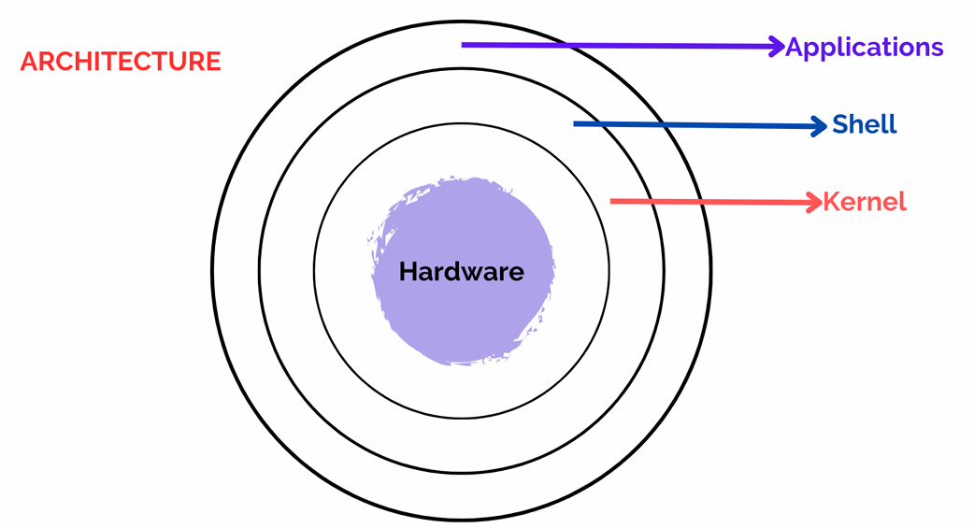
2–5. Core Linux concepts
Understand how the pieces fit together
Open source
Linux distribution
Operating system
Kernel
Open source means the source code of software is available for people to study, modify and redistribute according to its license.
Ex: A person can take Linux source code, modify it according to their requirements, and create a Linux distribution
A Linux distribution is a complete operating system built using the Linux kernel along with other software and tools. also calls distributions Flavors.
Ex: Ubuntu, Debian, Red hat, Kali Linux, rockylinux,amazonlinux.
An operating system is system software that acts as a bridge between the user, applications and computer hardware.
EX: When you type a command, the operating system helps process it and produce the result.
Ex: Linux, windows
It is the core or the heart of the operating system. It's the central part that manages and facilitates communication between the computer's hardware and software.
Kernel version command:
uname -r → displays the Linux kernel release/version.
A shell is a program that allows users to communicate with the operating system.
Types: CLI (Command Line Interface) and GUI (Graphical User Interface).
1. CLI (Command Line Interface)
Allows users to interact with the operating system by typing commands.
The output is displayed as text in the terminal.
Example: Linux Terminal, Bash shell.
2. GUI (Graphical User Interface)
Allows users to interact with the operating system using graphical elements such as icons, menus, and windows.
The output is displayed visually on the screen.
Example: Windows Desktop, Ubuntu Desktop.
Shell
Command
A command is an instruction given by a user to the operating system to perform a specific task.
Example: ls — lists files and directories.
Terminal
A terminal is a text-based interface where users type commands to interact with the Linux operating system.
Example: Typing pwd displays the current directory.
4

Slide 5
6–8. DevOps and Linux users
Different accounts have different levels of access
DevOps
Root user
Normal user
DevOps is a set of practices that combines software development (Dev) and IT operations (Ops) to improve collaboration and deliver software faster and more reliably.
Ex: Linux is a fundamental skill for DevOps engineers because many servers and DevOps tools run on Linux
The root user is the Linux superuser with extensive administrative permissions across the system
Ex: Like a king who has authority over a kingdom, the root user has broad control over a Linux system.
A normal user is an account with permissions limited by the system's configuration and assigned privileges
Ex: An ordinary user may not be allowed to install certain software or modify protected system files without administrative privileges
Root access is powerful: use it carefully and only when needed.
Normal user
Limited access → Broad access
Root / admin
5

Slide 6
9–16. Server and system vocabulary
Quick definitions to remember
Term | Easy definition | Class example
Hostname | A hostname is nothing but a server name | my-instance
IP address | IP Address: A numerical address used to identify a device and communicate over a network. Public IP: Used for communication over the internet. Private IP: Used for communication within a private network, such as an AWS VPC. | Public or private IP
Uptime | The time a system has been running since it was last started. | About 2 hours
CPU | The part of a computer that executes instructions and performs calculations. | Runs program instructions
RAM | Temporary memory used by the operating system and running applications. | Working memory
Storage | The space used to store system files, applications, and user data. | EBS volume
Process | A program that is currently running. | Background service
Time zone | A time zone determines the local time and date used in a particular region. | Asia/Kolkata
6

Slide 7
3. AWS cloud services discussed
Know the purpose of each service; start with EC2 practice
EC2
S3
VPC
Virtual servers in the cloud
Object storage for files and data
Logically isolated AWS network
RDS
SNS
Auto Scaling
Managed relational database
Notifications and messaging
Adjusts resource count based on configured conditions
Load Balancer
Route 53
CloudWatch
Distributes incoming traffic across targets
DNS and domain routing
Metrics, logs, monitoring and alarms
EKS
ECS
ECR
Managed Kubernetes service
Runs and manages containers
Container image registry
7

Slide 8
4. Categories of Linux commands
The instructor plans to teach categories step by step
System- Get operating-system and system information
Hardware-Check CPU, RAM and storage information.
uname, uptime | OS/system information
lscpu, free -h, lsblk | CPU, RAM and storage
File- Create, view and manage files.
Search- Find files or matching text.
touch, cat | Create, view and manage files
find, grep | Find files or matching text
Permissions- Manage file permissions.
Software- Install or manage software.
chmod, chown | Manage file permissions
dnf, apt | Install/manage software
Editors- Edit file contents.
Networking- Inspect network configuration.
vim, nano | Edit file contents
ip, hostname -I | Inspect network configuration
Users- Manage users and their privileges.
Processes- Inspect or control running processes.
useradd, passwd | Manage users and privileges
ps, kill | Inspect/control processes
8

Slide 9
5. Launch an AWS EC2 instance
Use a cloud Linux server for hands-on practice
Class demonstration setup
Your computer
AWS EC2
• Launch an EC2 instance in AWS
• Select an appropriate Amazon Machine Image (AMI)
• Demonstrated instance type: t3.micro
• Attach an 8 GB EBS volume
• Reuse an existing security group only if it meets requirements
EBS storage
Connect to the instance
Windows: PuTTY
macOS/Linux: terminal
EC2 instance = a virtual computer running in AWS.
Security reminder: configure the security group and SSH access securely. Do not expose SSH to everyone unless there is a specific, justified need.
9

Slide 10
6. Switching users
Commands demonstrated in class
Task | Command
Switch to root with login environment | sudo -i
Alternative shown in class | sudo su -
Return to previous shell | exit
Exit shell using keyboard | Ctrl + D
Check login identity | who am i
Example
sudo -i
You enter a root shell.
Important distinction
Use sudo -i or sudo su - for the login-shell environment. sudo su without the hyphen does not set up the same login environment.
Root has extensive privileges. Return to your normal user when administrative work is complete.
10

Slide 11
7. System commands — Get operating-system and system information.
Commands central to the first practical session
Command | Purpose
uname | Operating-system kernel name
uname -r | Kernel release/version
uname -a | Detailed system and kernel information
uptime | Uptime, logged-in user count and load averages
uptime -p | Human-readable uptime
who | Logged-in user sessions
who am i | Identity associated with current login session
hostname | System hostname
hostname -I | Configured IP addresses, commonly private IP on EC2
hostnamectl set-hostname my-instance | Changes system hostname
11

Slide 12
System commands — IP, date and history
Examples you can practise on your instance
Command | Purpose
curl ifconfig.me | To see the public IP
date | Displays system date and time
cal | Displays current-month calendar
cal 2026 | Displays the calendar for 2026
timedatectl | Displays date, time and time-zone settings
timedatectl set-timezone Asia/Kolkata | Sets time zone to India Standard Time
history | Displays previously entered shell commands
Remember
An EC2 instance does not necessarily have a public IP. The curl result depends on the network path and external service.
12

Slide 13
8. Public IP vs private IP
Both identify network interfaces, but they serve different roles
Public IP
Private IP
Used for communication over the internet.
It is assigned to an instance or connected through AWS networking.
It may change depending on the configuration.
We can check it using an online IP-checking website.
A private IP is used for communication within a private network.
It is assigned to an EC2 instance inside a VPC.
It usually remains the same while associated with the network interface.
We can check it using the hostname -I command.
Internet
AWS VPC
EC2 instance
13

Slide 14
9. Date, time and calendar commands
Time-zone configuration and formatting
Display date/time
Calendar
Time-zone settings
date
Shows the current system date and time.
cal
cal 2026
cal 1993
timedatectl
Displays configured time zone and clock information.
Set India time zone
Specifier | Meaning
%d | Day of month
%m | Month number
%y | Two-digit year
%Y | Four-digit year
%H | Hour, 24-hour format
%M | Minutes
%S | Seconds
%D | MM/DD/YY
%F | YYYY-MM-DD
%A | Full weekday
%B | Full month
sudo timedatectl set-timezone Asia/Kolkata
14

Slide 15
10. Hardware commands — Check CPU, RAM and storage information
CPU information
RAM information
lscpu
Displays CPU architecture, processor count and other CPU details.
cat /proc/cpuinfo
Reads detailed processor information from the Linux /proc interface.
free
Displays memory usage.
free -h
Shows memory values in human-readable units.
CPU = executes instructions
free -h output includes:
• Total memory
• Used and free memory
• Shared memory
• Buffer/cache and available memory
Fetch
Decode
Run
Repeat
Remember: RAM is working memory; it is not the same as disk storage.
15

Slide 16
Hardware commands — storage devices
EBS, disks, partitions and filesystem usage
Command | Purpose
lsblk | Lists block devices such as disks and partitions
df -h | Displays filesystem storage usage in human-readable units
sudo fdisk -l | Lists disk and partition information
EC2 instance
EBS volume
8 GB
Filesystem
Files/data
Three commands to memorise
free -h = RAM information • df -h = filesystem storage usage • lsblk = list storage devices
Class example: an EC2 instance has an 8 GB EBS volume; OS files already occupy some space.
16

Slide 17
11. Clearing the terminal
Clean the screen without deleting data
Linux command
Keyboard shortcut
Windows Command Prompt
clear
Clears the visible terminal screen.
Ctrl + L
Also clears the visible terminal screen.
cls
Commonly used in Windows Command Prompt rather than standard Linux shells.
$ clear
[terminal screen refreshed]
$ _
Clearing the screen does not delete files or erase shell command history.
17

Slide 18
12. Process management
A process is a program that is currently running
Simple definition
Class analogy
A process is a running instance of a program.
A phone may run an alarm, a game and other apps in the background. A Linux server can run services such as Jenkins or Docker.
Command | Purpose
ps | Displays processes associated with the current terminal.
ps -ef | Displays a detailed list of processes running across the system.
kill -9 PID | Forcefully stops the process with the specified Process ID (PID).
Example and safety
sudo kill -9 1234 • 1234 is only an example PID. Identify the correct process first. SIGKILL forcefully terminates it without normal cleanup; do not kill unfamiliar processes.
18

